Slide 1
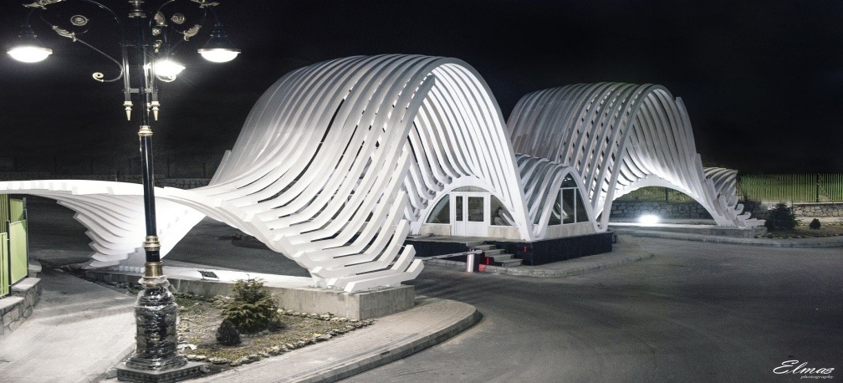
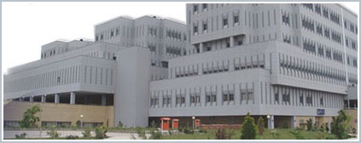
Nocturia & Menopauses
All You Have To Know
Sakineh Hajebrahimi, MD
Professor of Urology &Neurourology Department, Research center for EBM, TUMS, Tabriz, Iran

Slide 2



Lower Urinary Tract Symptoms
Storage
symptoms
Voiding
symptoms
Post-micturition
symptoms
Altered bladder sensations
Increased daytime frequency
Nocturia
Urgency
Urgency incontinence
Hesitancy
Intermittency
Slow stream
Splitting/spraying
Straining
Terminal dribble
Feeling of incomplete bladder emptying
Post-micturition dribble
LUTS are unspecific, overlapping, and have a multifactorial etiology: bladder, prostate, urethra, pelvic floor, central or peripheral nervous system, kidneys, rectum …
Knutson T et al. Neurourol Urodyn. 2001;20: 237 – 247.
Abrams P et al. Neurourol Urodyn. 2002; 21: 167 – 178.

Slide 3

Definition of Nocturia (ICS)
Waking to pass urine during the main sleep period (≥1 time per night), independent on age, gender, causes or associated bother. Each void is preceded and followed by sleep or the intention to sleep.
The first morning void is excluded from the count – although urine production of the first void occurred at night
D‘Ancona C et al. Neurourol Urodyn. 2019; 38: 433 - 477.
Hashim H et al. Neurourol Urodyn. 2019; 38: 499 - 508.

Slide 4
What is the Prevalence of Nocturia?

Slide 5
What affects the occurrence of nocturia more: menopause or age?
“the increasing occurrence of nocturia is age-related and is not affected by the transition from pre- to postmenopause”
Tzu-LiLinaSoo-CheenNgbYi-ChingChencSuh-WoanHudeGin-DenChenb

Slide 6
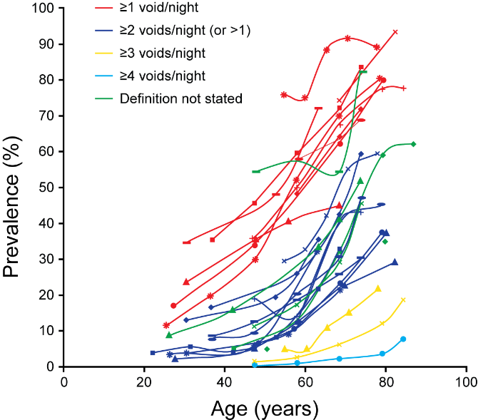
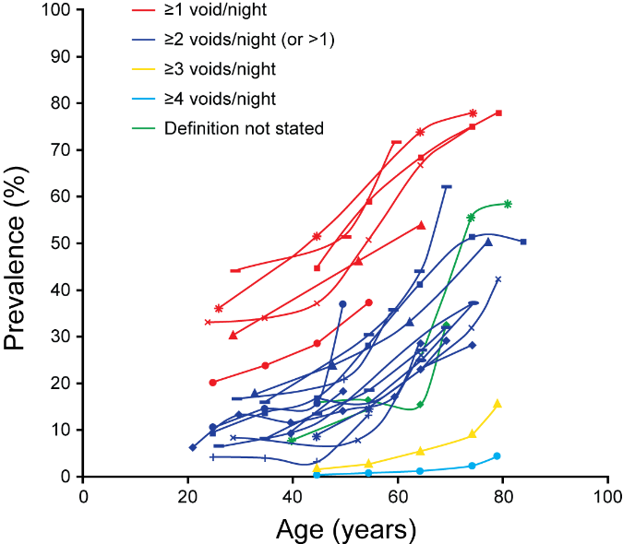
Nocturia Increases With Age
Systematic review of the literature: 43 studies on the prevalence of nocturia in adults
Men
Women
Nocturia and nocturia severity increase with age for both genders
Most people had only one nocturnal void
Bosch JL und Weiss JP. J Urol 2013; 189: S86 – 92.

Slide 7
Why Treat Nocturia?

Slide 8
Nocturia is the Most Common Cause of Sleep Disturbance
Survey among 8937 adults across 3 US states
100
Reasons Cited as “Often” Causing Sleep Disturbance
80
18 - 44 yrs
45 - 64 yrs
≥65 yrs
60
Respondents (%)
40
20
0
Pain
Urination
Woken by
partner
Child
Noise
Hunger
Thirst
Dream
Difficulty
breathing
Spontaneous
awakening
Ohayon MM. J Psychiatr Res. 2008; 43: 48 - 54.

Slide 9
SWS May Be Interrupted by Nocturia
The first nocturia episode occurs within 2 to 3 hours on average ¹
1st nocturia episode
Stages ²
Awake
1
REM
REM
REM
REM
REM
2
3
SWS
4
0
1
2
3
4
5
6
7
hours of sleep
SWS phases
1. van Kerrebroeck P et al. Eur Urol. 2007; 52: 221 - 229.
2. Stanley N. Eur Urol Suppl. 4: 17 – 19.
Courtesy of Prof. Donald Bliwise

Slide 10
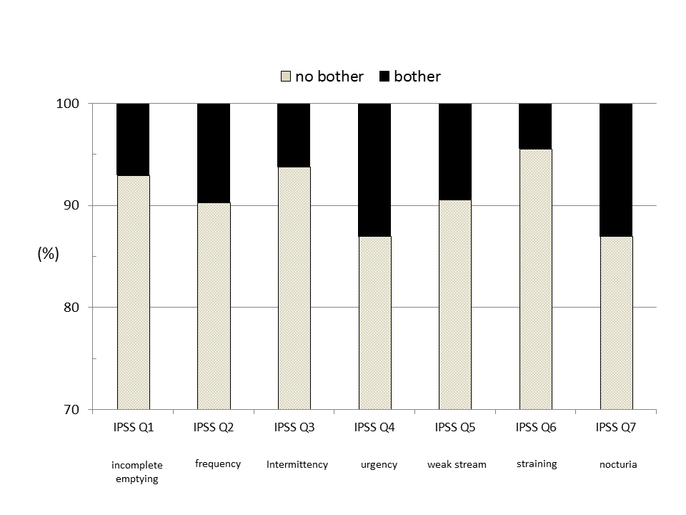
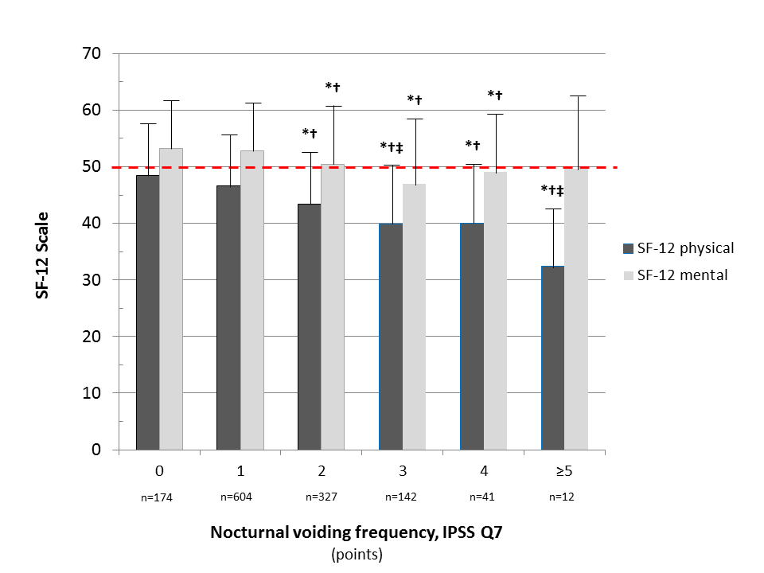
≥2 Voids Per Night Are Bothersome
Epidemiological survey in Germany (district of Herne)
1562 men aged 50-80 years
SF-12 questionnaire, generic HRQoL form to determine physical and mental health compared to other people in the same country (50 = average of HRQoL of population)
Continuous decline in physical (mental) health scale with increasing nocturia frequency
Bother (IPSS 8)
Quality of Life (SF-12)
average German population
13%
13%
Oelke M et al. World J Urol. 2014; 32: 1155 – 1162.

Slide 11
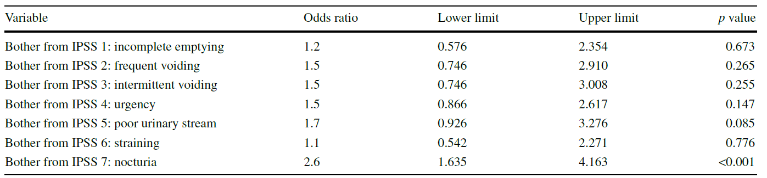
Health Care Seeking Behavior
follow-up investigation of the original study population in Herne 2 years after the initial assessment
have you visited a doctor for LUTS during the last 2 years?
multivariate regression analysis using patient-reported bother from each symptom of the IPSS questionnaire (AUA-SPI)
only nocturia was significantly associated with medical consultations
Oelke M et al. World J Urol. 2014; 32: 1155 – 1162.

Slide 12
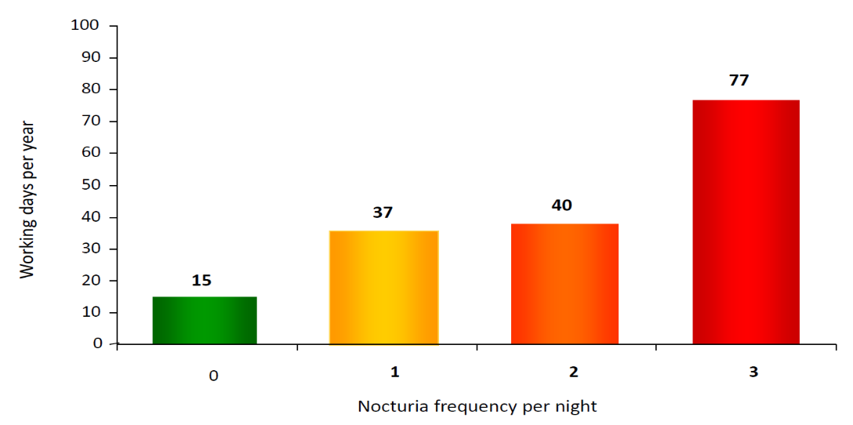
Consequences of Nocturia
Falls and fractures↑, annual costs associated with fractures:
  USA: approx. $ 1.5 billion/year
  Europe: approx. € 1 billion/year
Travel (car) accidents↑
Missing at work, annual costs
associated with loss of work
productivity:
  USA: approx. $ 62.5 billion/year
  Europe: approx. € 29 billion/year
Diabetes mellitus↑
Cardiovascular diseases↑
Mortality↑
Missing days at work
van Dijk BJU Int. 2002; 90: 644-648. Nitti Rev Urol. 2002; 4(suppl 4): S2 - S6.
Weiss J Urol. 2000; 163: 5-12. Hetta BJU Int. 1999; 84(suppl 1): 27 - 28.
Lose Am J Obstet Gynecol. 2001; 185: 14 - 21.
Holm-Larsen T. Neurourol Urodyn. 2014; 33: S10 – S14.

Slide 13
Nocturia and Mortality: US Data NHANES III
≥2 voids/night are associated with worse survival
in a population-based sample of 7,455 men and 8,533 women
Kupelian et al. J Urol. 2011; 185: 571 – 577.
Courtesy of Prof. Dr. Jeff P. Weiss, Brooklyn, NY, USA

Slide 14
What Causes Nocturia?

Slide 15
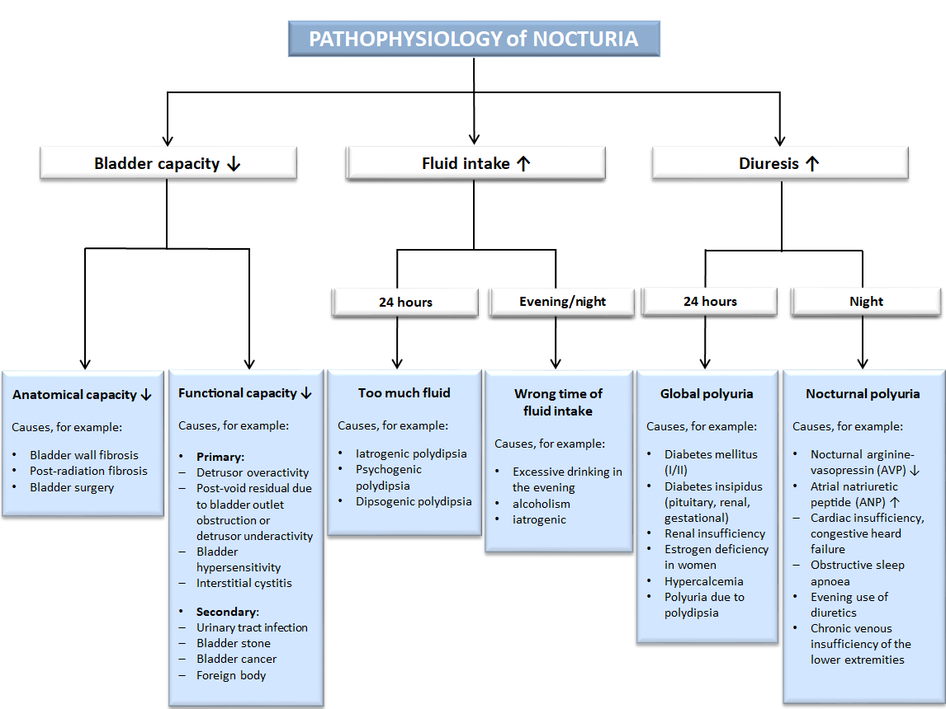
Oelke M et al. World J Urol. 2014; 32: 1109 – 1117.

Slide 16
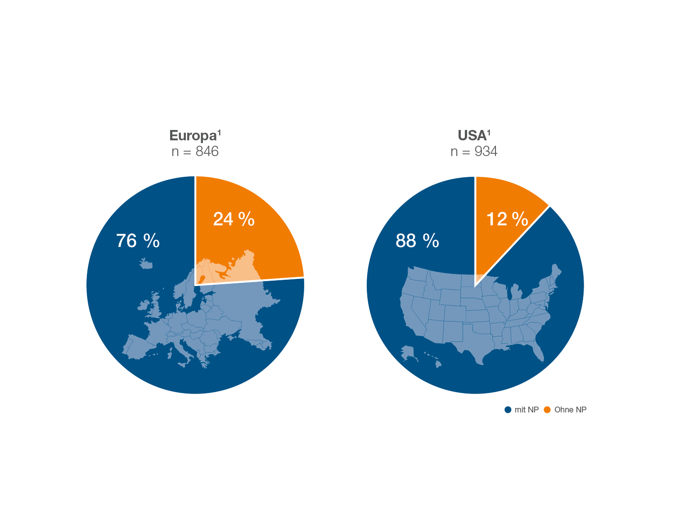
Nocturnal polyuria is present in a large proportion of patients with nocturia
with
without nocturnal polyuria
Weiss JP et al. J Urol. 2011; 186: 1358 – 1363.
Chang et al. Urology 2006; 67: 541 – 544.

Slide 17
Multiple Causes In Any Individual Patient
Nocturnal
polyuria
Polyuria/
polydipsia
Oedema
BOO
Detrusor
overactivity
Diabetes
mellitus
Detrusor
overactivity
van Kerrebroeck P et al. Int J Clin Pract. 2010; 64: 807 - 816.

Slide 18
How To Assess Nocturia?

Slide 19
Tools to Assess Nocturia
Assessment Tool | Advantages | Disadvantages/Limits
Frequency-Volume chart, bladder diary | Assumed to be most reliable tool Allows differentiation of polyuria and other causes | Requires detailed instruction to patient Not often applied outside overactive bladder treatment studies
IPSS question 7 | Quantitative Data from many studies on male voiding dysfunction available for comparison | Recall-based Not validated against definition by ICS
N-QoL score | More specific than IPSS questions Validated for nocturia Symptom-specific QoL Recommended by ICS | Recall-based Used in few epidemiological or treatment studies
Hours of undisturbed sleep | Mechanistically linked to factor impairing QoL | Optimal method of assessment still under discussion Used in few epidemiological or treatment studies
Oelke M and van Kerrebroeck P. In: Current Aspects on Diagnosis and Treatment of Nocturia. Uni-Med Science 2012: 79 – 90.

Slide 20
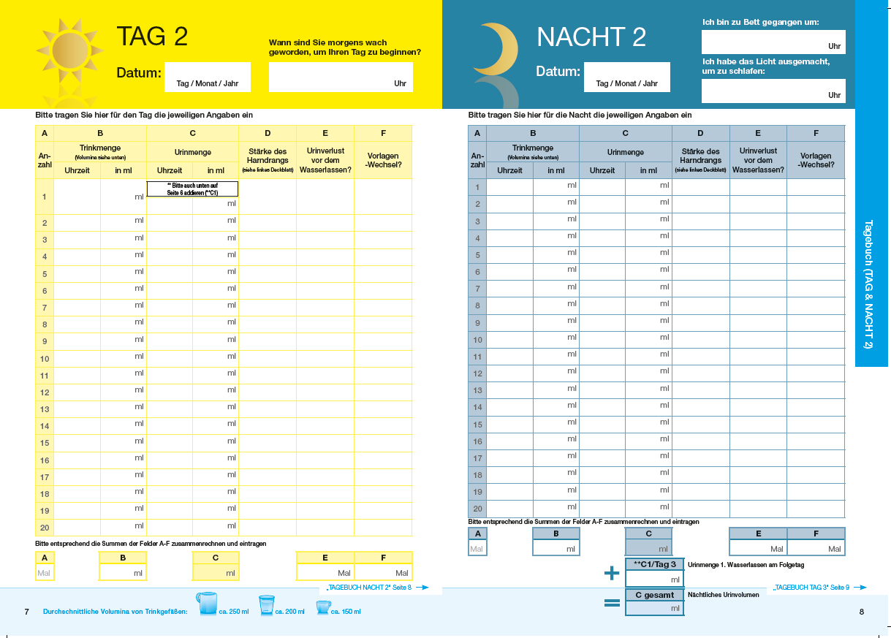
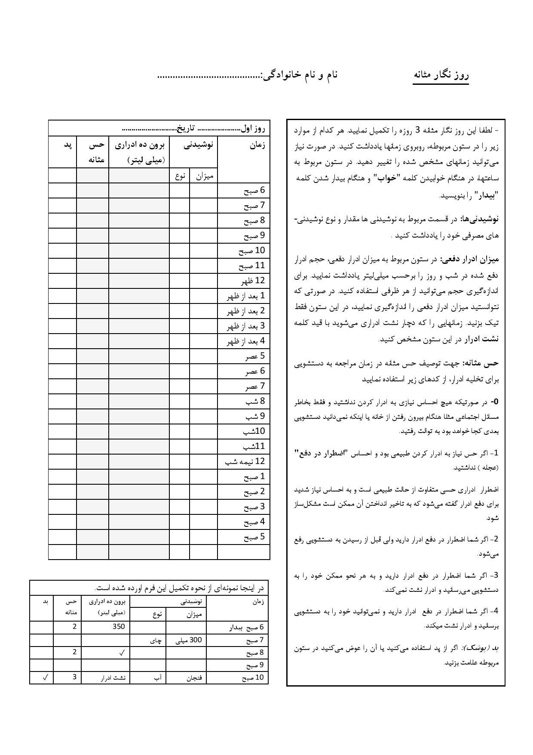
Bladder Diaries: Careful Diagnosis Is Essential For Optimum Treatment Outcomes

Slide 21
Measures Obtained From Frequency-Volume Charts
Frequency–volume charts (FVCs) provide valuable information regarding voiding frequency and urinary volumes for 24–72 hours ^{1–3}
Chart may also record volume and type of fluid ingested, time of retiring to bed and time of rising
Nocturia
Nocturnal urine volume
>33% of 24-h urine volume
24-h urine volume
>40 mL/kg
Urinary frequency
Reduced maximum voided volume
Global polyuria
(24h polyuria)
Nocturnal polyuria
OAB
BOO
Reduced bladder capacity
- anatomical
- functional
1. Weiss JP et al. BJU Int. 2011; 108: 6 – 21.
2. van Kerrebroeck P et al. Neurourol Urodyn. 2002; 21: 179 – 183.
3. van Kerrebroeck P et al. Int J Clin Pract. 2010; 64: 807 – 816.

Slide 22
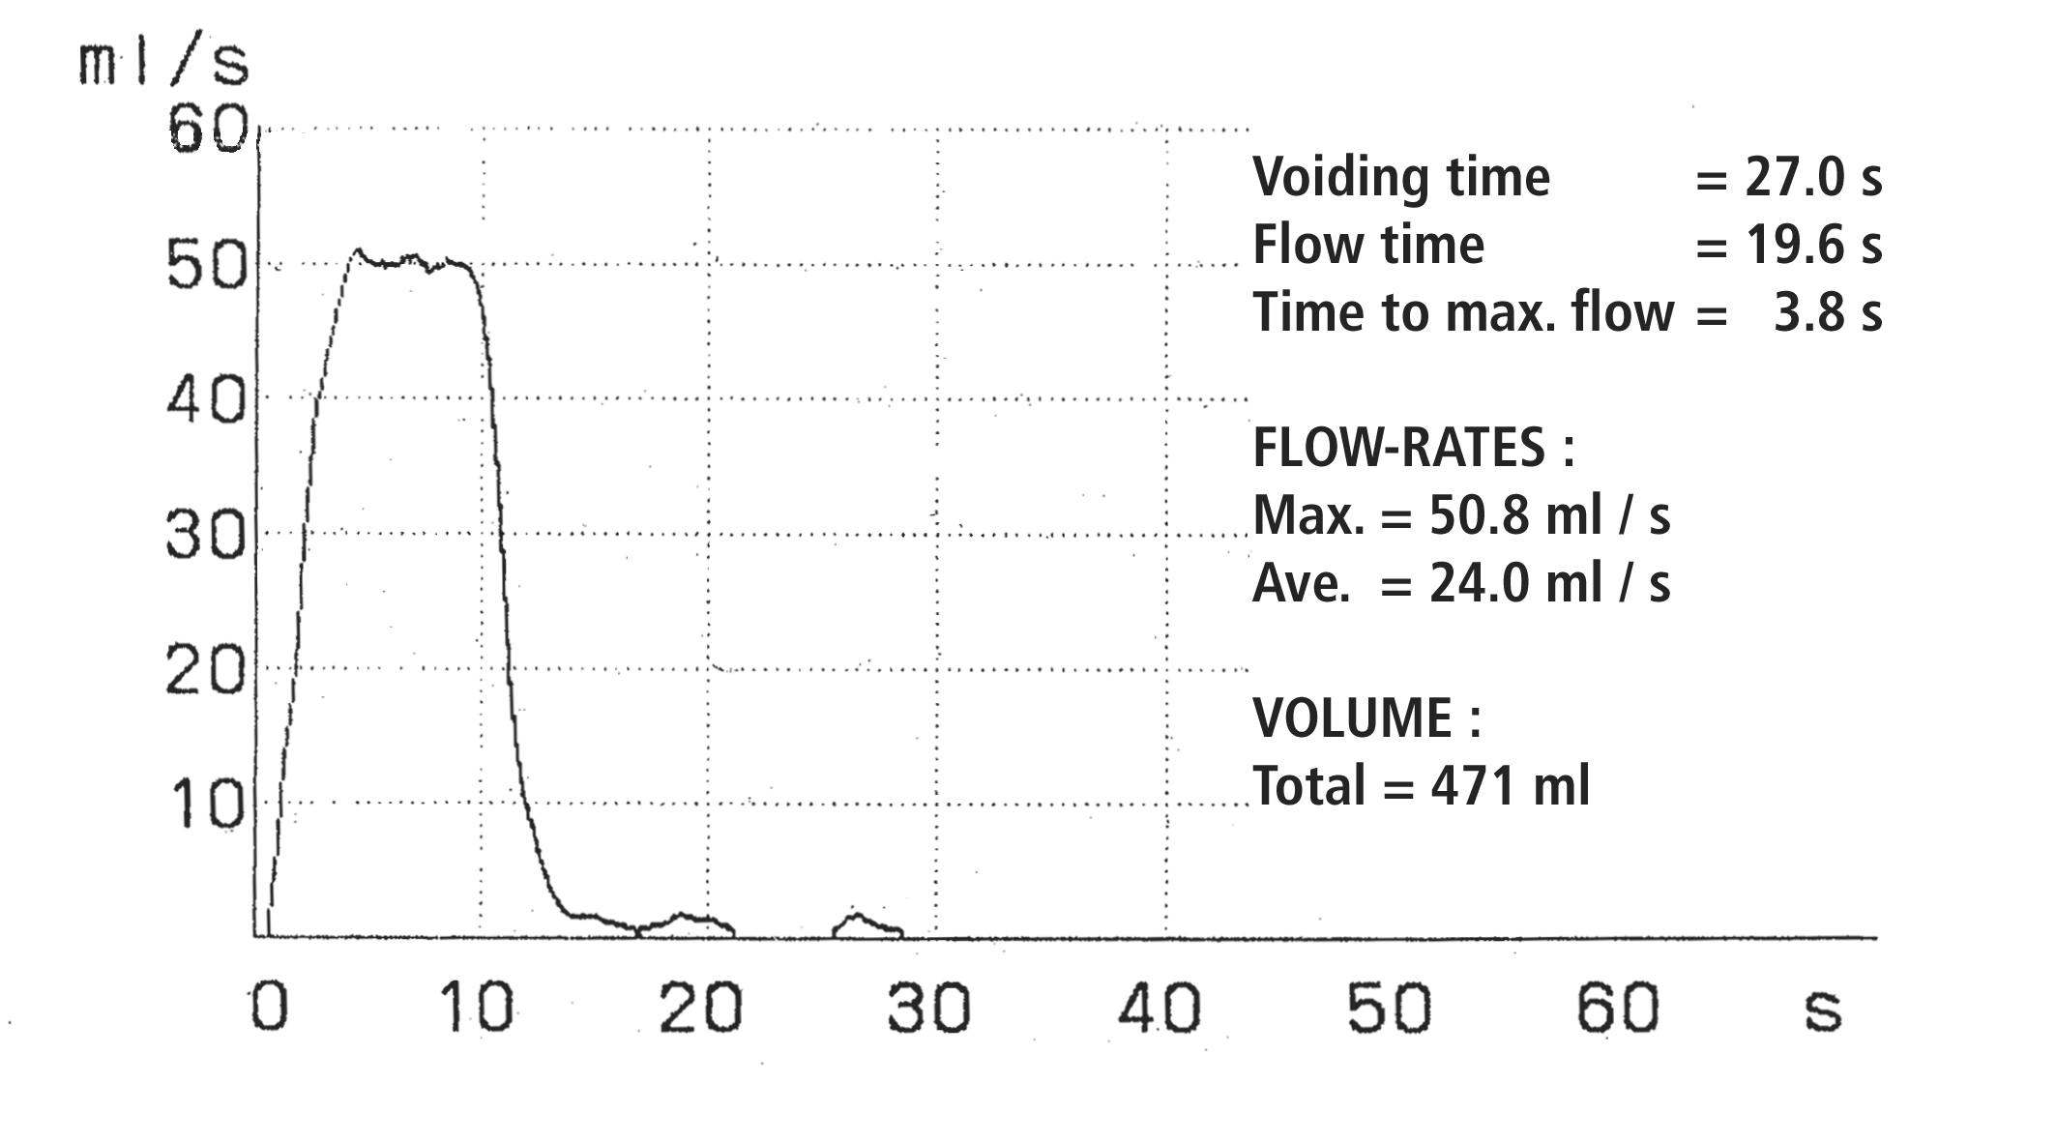
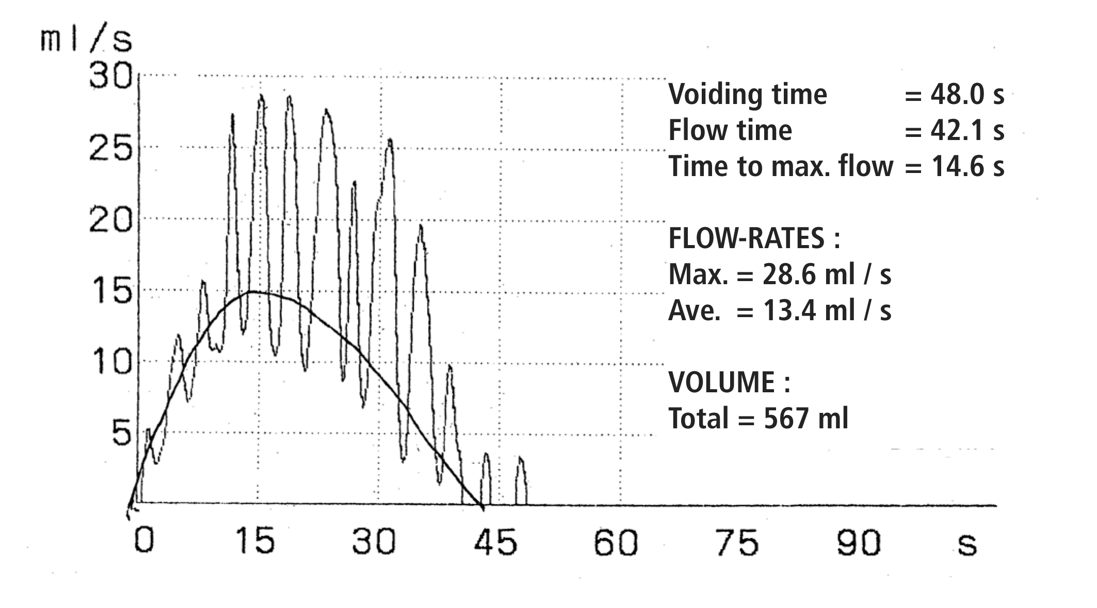
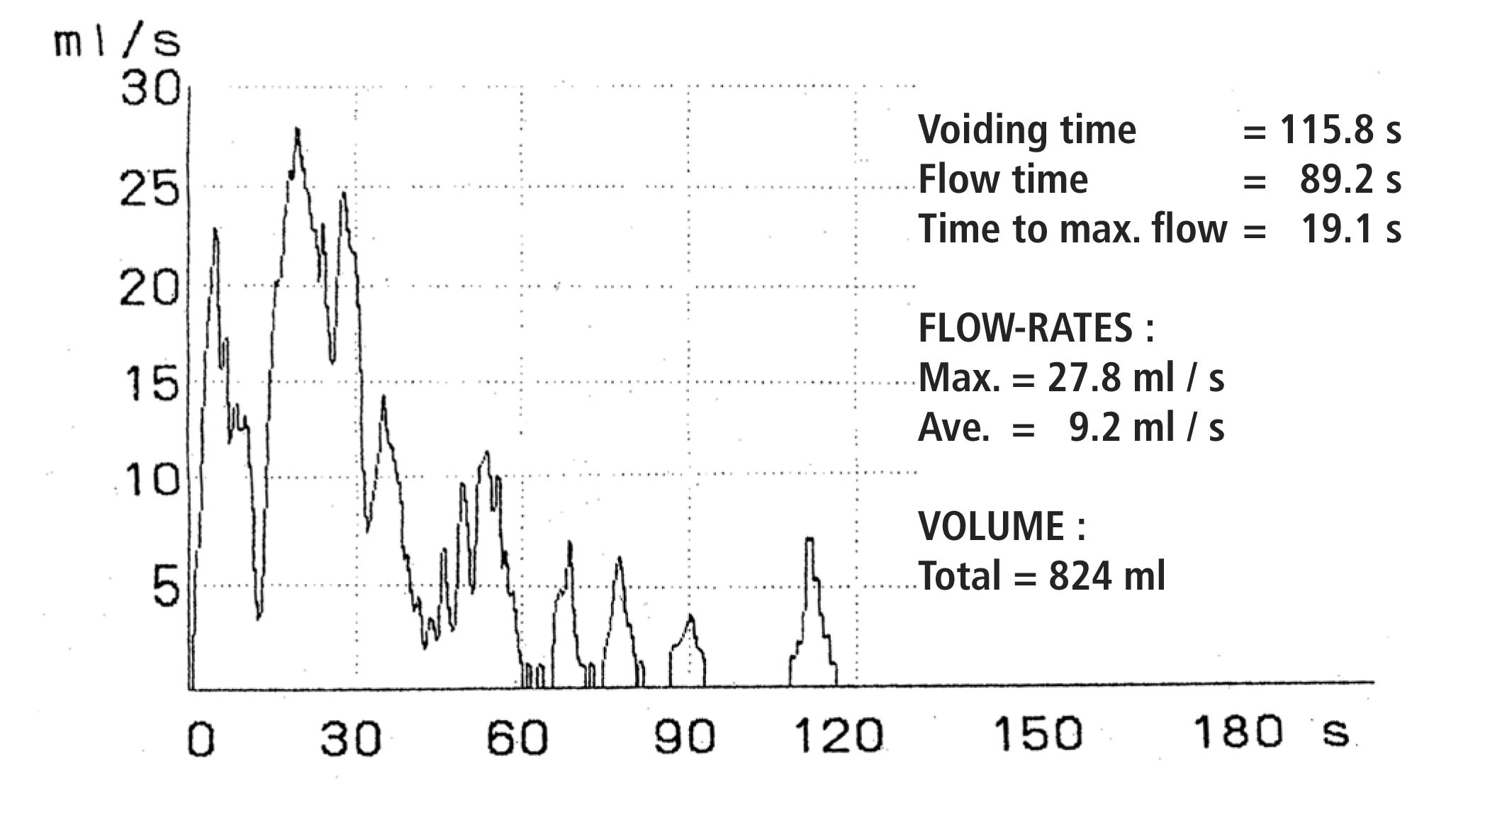
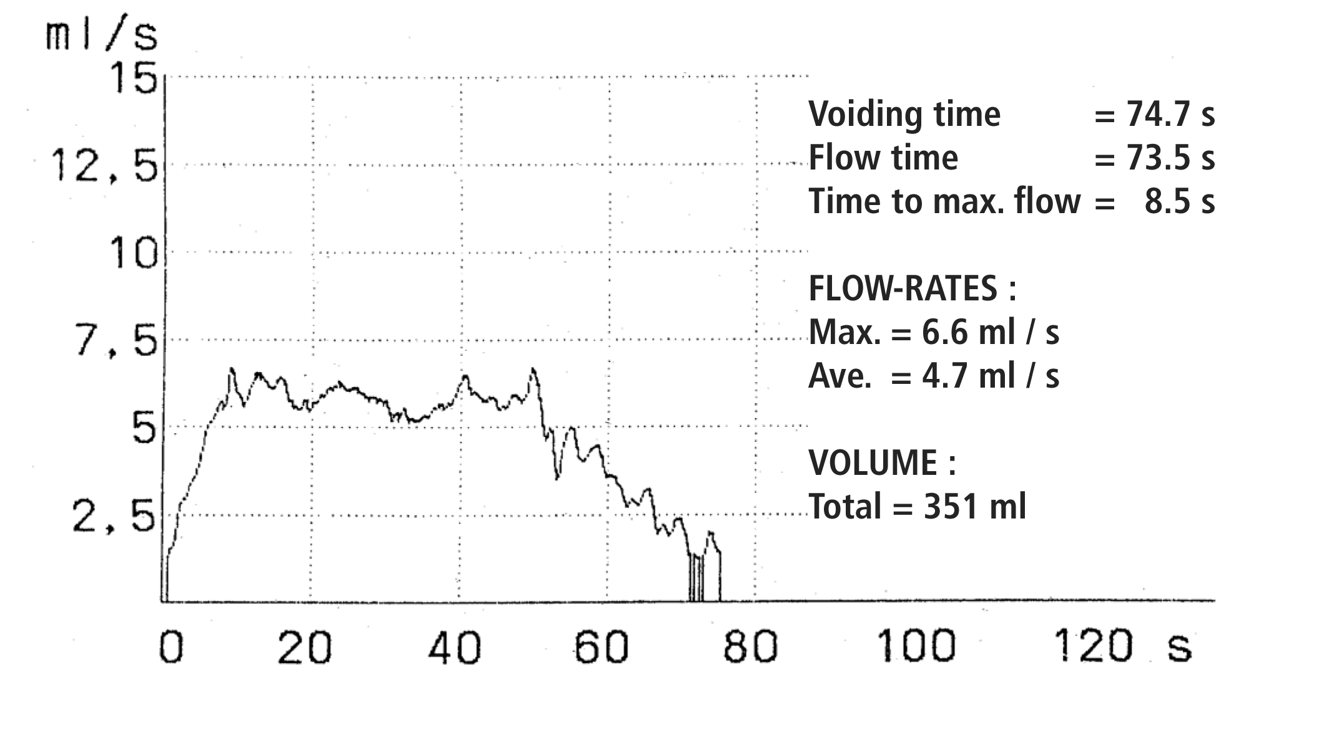
Uroflowmetry
Supra-normal
(after TURP)
Bell-shape
(normal)
Stakkato-flow
(dysfunctional voiding, straining)
Plateau-flow
(BPO, detrusor underactivity)
Images: Private Slide Collection Matthias Oelke

Slide 23
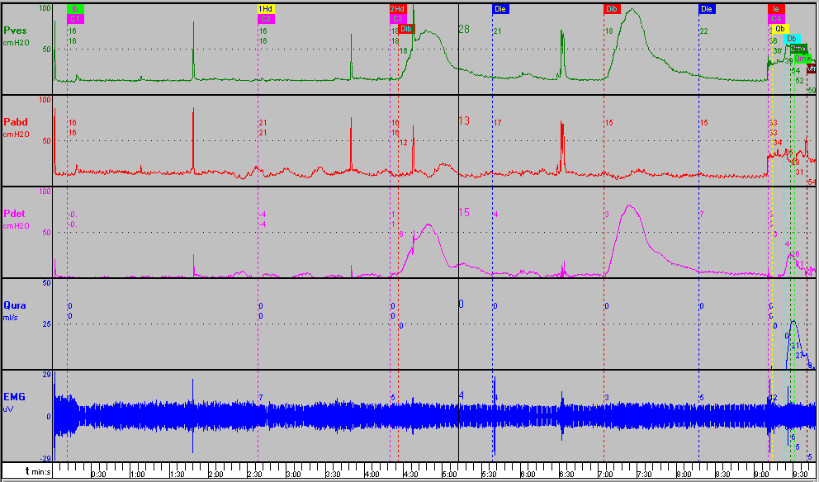
Detrusor Overactivity
Images: Private Slide Collection Matthias Oelke

Slide 24
How To Treat Nocturia?

Slide 25
Treatment Philosophy
do not treat symptomatically without careful assessment of the patient, always use frequency-volume charts at baseline
exclude treatable underlying causes of nocturia (e.g. bladder cancer, bladder stone)
always consider the multifactorial etiology of the symptom and think of concomitant diseases
treat the most severe pathophysiological component first
treatment should prolong the first uninterrupted sleep period to >4 hours

Slide 26
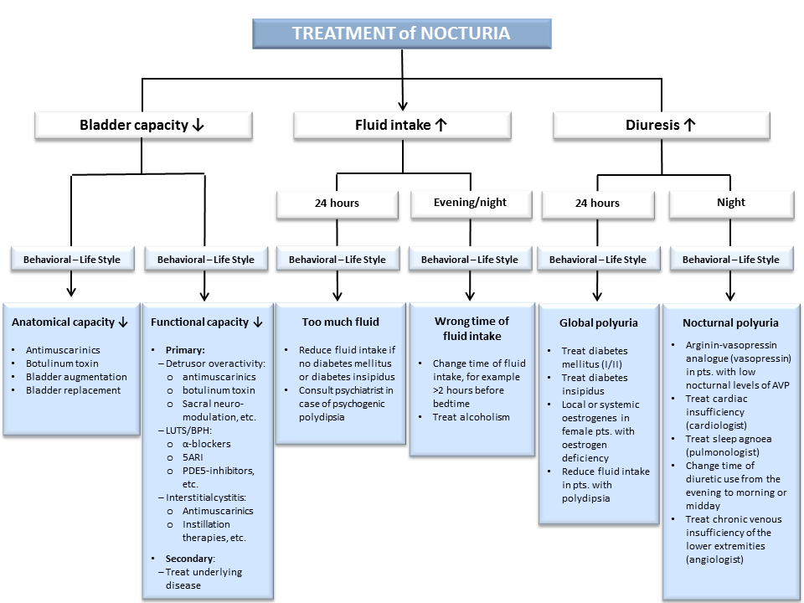
Oelke M et al. World J Urol. 2014; 32: 1109 – 1117.

Slide 27
Take-Home Messages
nocturia has a multifactorial etiology and may have several causes in the individual patient
careful assessment is necessary to evaluate the pathophysiology behind nocturia; treatment should focus on the underlying pathophysiology
Treatment goal: ≥4 hours of undisturbed sleep
antimuscarinics have a limited effect on nocturia, although some patients experience substantial improvement
“prostate“ drugs usually have a limited effect on nocturia in patients with LUTS/BPH; however, some patients still profit substantially
desmopressin is the drug of choice in patients with nocturnal polyuria and shows clinically meaningful improvements in clinical practice

Slide 28

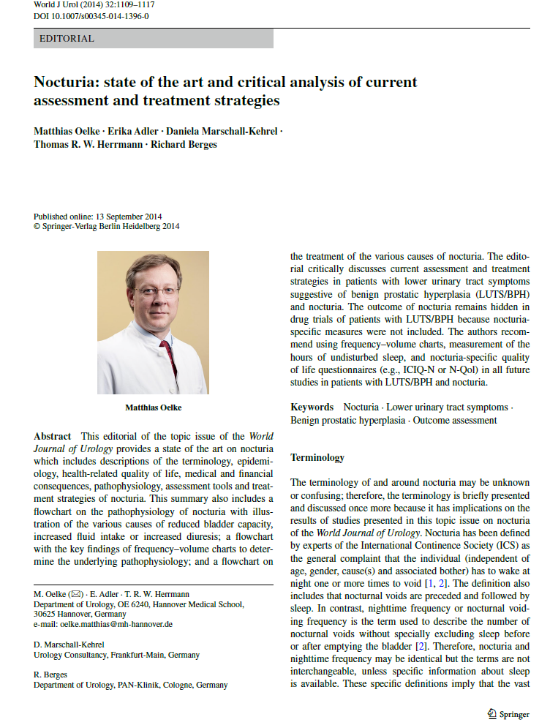
Recommended Literature

Slide 29
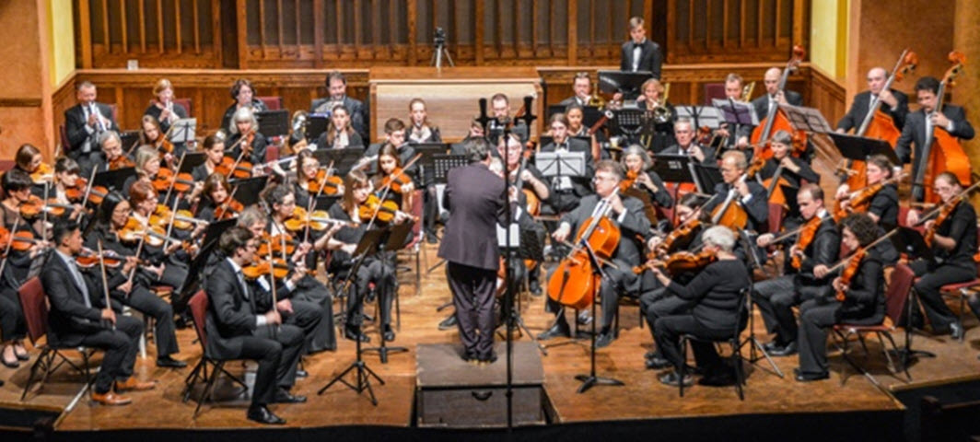
Conclusion
Management and monitoring of LUTS will likely be orchestrated and instrumental, and that process requires “good evidence based practice”

